Slide 1
Activity, Intent and UI design
Università di Modena e Reggio Emilia

Slide 2
Application life-cycle and priority
Apps have limited control over their lyfe-cycle.
Every Android application runs in its own Linux process.
Memory and process management is handled by ART. Android assigns resources and determines which processes should be killed on the basis of process priority:
Active process (Top Priority): have active components which is interacting with user (e.g. user is typing in a search box)
Visible process (High Priority): visible but inactive components (e.g. an activities partial obscured by a pop up element)
Started background service process (Medium priority): hosting backgroud services that have been started
Background process (Low Priority): hosting activities wthat aren’t visible and don’t have running services (e.g. when you tap home screen or recent applications button, activity that was running go in background)

Slide 3
Application core components
App is composed by several elements, bounded in Android Manifest (which describe each of them and how they interact)
Activities: app presentation layer. The app’s UI is built around activities, which use Views and Fragments to display info and interact with user
Services: run without UI (update data, trigger notifications…)
Broadcast receivers: used to configure app to listen only Intents that math your specifications
Content providers: used to share data across application boundaries
Intents: inter and intra application way to exchange massages, you can start Activities, Services…
Notifications: used to alert user to application events without interrupting current Activity

Slide 4
Activity
Unlike programming paradigms in which app are launch with a main(), the Android system initiates code in an Activity by invoking specificic method.
Why? In mobile-app, user's interaction doesn't always begin in the same place (e.g. app could be started with the launch icon and user might see a specific window, but, it could be started also using another app and user might se another different window). Activity is design to facilitate this paradigm, it serves as the entry point for an app's interaction with the user
An activity provides the window in which the app draws its UI.

Slide 5
Activity lifecycle
When user navigate through an app, the Activity instances transition through different states of their lifecycle.
Activities in the system are managed as activity stacks by ActivityManager using LRU-mechanism (When a new activity is started, it is usually placed on the top of the current stack and becomes the running activity -- the previous activity always remains below it in the stack, and will not come to the foreground again until the new activity exits.)
Entire lifecycle is related to specific methods which are invoked by the system; developers can override them

Slide 6
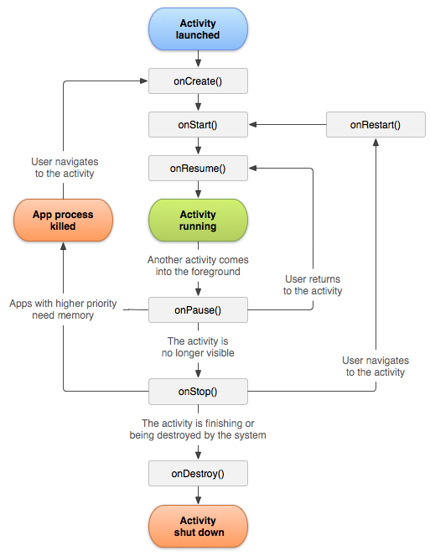
Activity lifecycle
Activity has 4 states (represented by oval):
Active or running: if activity is in the foreground of the screen (it is at the top of the stack). The user is interacting with.
Visible: If activity has lost focus but is still presented to the user (e.g. if activity has partial obscure by a pop-up) (activity is alive and maintains all information)
Stopped or hidden: if activity is completely obscured by another activity. (it maintains information but it could be killed by the system)
Destroyed: if activity is dropped from memory

Slide 7
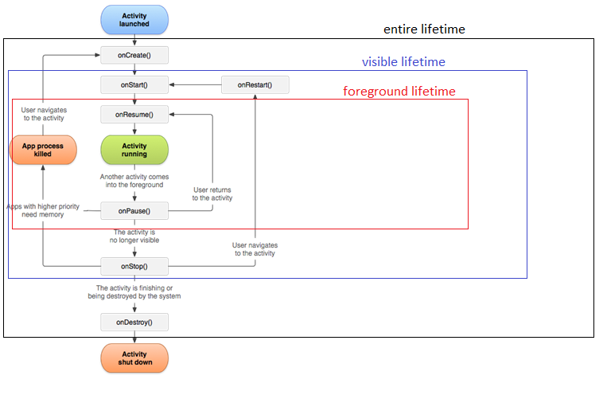
Activity lifecycle
We can distinguish 3 loops:
Entire lifetime: from onCreate(), where activity setup global stae, until onDetroy(), where activity release all resources
Visible lifetime: from onStart() until onStop(), user can see the activity on screen, but it couldn't be in foreground
Foreground lifetime: from onResume() until onPause(), user is interreacting with activity

Slide 8
Activity class
Activity class takes care of creating a window for you in which you can place your UI
Is located in android.app
Extends ApplicationContext which is an implementation of Context, represent an interface to global information about an application environment. This is an abstract class whose implementation is provided by the Android system. It allows access to application-specific resources and classes, as well as up-calls for application-level operations such as launching activities, broadcasting and receiving intents, etc.
public abstract Context getApplicationContext () is an abstract method which return a context
https://developer.android.com/reference/android/app/Activity

Slide 9
Activity class methods
public T findViewById (int id)
public void setContentView (View view)
public void setContentView (int id)
public void finish()

Slide 10
Activity class methods
Activity class provide setContentView method which is use to present UI layout, Both the width and the height of the view are set by default to match_parent (full screen)
public void setContentView(View view): Set the activity content to an explicit view. This view is placed directly into the activity's view hierarchy. If you create UI with java you must use this.
public void setContentView(int layoutId): Set the activity content from a layout resource. Int is the resource id to be inflated, which can be accessed using R class (R.layout.ResourceId)
setContentView(R.layout.activity_main)

Slide 11
Activity class methods
public T findViewById (int id)
Activity and View class provide this generic method to allow the creation of View-subclass instances from a Resource id.
Depending on compiler support, explicit casting is necessary or not.
TextView tvTitolo = findViewById(R.id.tv_titolo)

Slide 12
Activity class methods
public void finish()
Call this when your activity is done and should be closed.
The ActivityResult is propagated back to whoever launched you via onActivityResult().

Slide 13
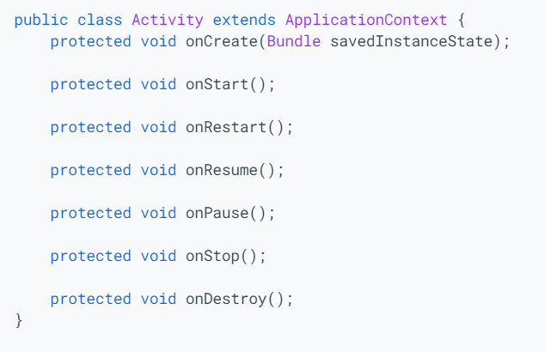
Managing activity lifecycle
Developer can modify and manage activity lifecycle using 6 methods, which are called by the system at every state transition
If you override this methods you must call through to the superclass implementation.

Slide 14
onCreate()
This method is required.
Called when the activity is first create, it enters in the created state.
In this method you setup activity, that should happen only once in entire activity lifecycle
You can manage only views which are included in layout set with setContentView
If Activity was already create savedInstanceState contains previous information stored by activity, otherwise is null

Slide 15
onStart()
When the activity enters the Started state, the system invokes this method
onStart() call makes the activity visible to the user but it isn't already interactive
Called after onCreate() or onRestart() when the activity had been stopper, but is now again displayed to the user
Once the execution of onStart() finishes, activity enters in Resume state and system invokes onResume()

Slide 16
onResume()
When the activity enters the Resumed state, it comes to the foreground, and then the system invokes onResume(). This is the state in which the app interacts with the user.
The app stays in this state until something happens to take focus away from the app, in which case activity enters the Paused state, and system invokes onPause()
If the activity returns to the Resumed state from the Paused state, the system once again calls onResume()
In this method you should implement

Slide 17
onPause()
Called as part of the activity lifecycle when the user no longer actively interacts with the activity, but it is still visible on screen.
Use onPause() to pause operations and release system resources that should not continue while activity in in paused state, NOT use onPause to save user data or do other "heavy" operation, such as database-transaction.
At the end of execution Activity remains in paused state until activity resumes or become completely invisible.

Slide 18
onStop()
Called when you are no longer visible to the user, and enters in Stopped state.
This is a good place to release resources that are not needed while the app is not visible to the user such us stop refreshing UI, running animations and other visual things.
You can use onStop() to perform CPU-intensive operations, such us save information to a database

Slide 19
onRestart()
Called after onStop() when the currently activity is being re-displayed to the user.

Slide 20
onDestroy()
Is called before the activity is destroyed and enters Destroyed state, system invokes this method because:
The activity is finishing (user dismissing activity or finish() being called)
System is temporarily destroying activity ( such us in device rotation)
This method is usually implemented to free resources like threads that are associated with an activity, so that a destroyed activity does not leave such things around while the rest of its application is still running.

Slide 21
Saving and restoring UI state
There are 2 scenario in which activity is destroyed by the system:
User press back button, this action represent a finish() call
System destroyed activity which isn't in foreground to preserve resources
In the first scenario, you not have to do anything because user's expectation corresponding to the system behaviour.
In the second scenario, if the user want to navigate back to the activity the system create a new instance of that activity using a set of saved data that describes the state of the activity when it was destroyed.
The saved data that the system uses to restore the previous state is called the instance state and is a collection of key-value pairs stored in a Bundle object.
By default, the system uses the Bundle instance state to save information about each View object in your activity layout. However, your activity might have more state information that you'd like to restore, such as member variables that track the user's progress in the activity.

Slide 22
Bundle
used across process boundaries such us with IPC transactions, between activities with intents or to store state across configuration changes.
Parcelable is an interface for classes whose instances can be written to and restored from a Parcel (Container for a message (data and object references) that can be sent using IPC.)
Bundle is a mapping String key-Parcellable values
Bundle class provide getters and put methos which allow you to pick-up and to insert data

Slide 23
Saving state
protected void onSaveInstanceState (Bundle outState)
Used to save simple and lightweight UI states from an activity before being killed, that the state can be restored in onCreate() or onRestoredInstanceState().
The default implementation takes care to save the state of the view hierarchy, calling View.onSaveInstanceState() for each view.
static final String STATE_SCORE = "playerScore"; static final String STATE_LEVEL = "playerLevel"; // ... @Override public void onSaveInstanceState(Bundle outState) { // Save the user's current game state savedInstanceState.putInt(STATE_SCORE, currentScore); savedInstanceState.putInt(STATE_LEVEL, currentLevel); // Always call the superclass so it can save the view hierarchy state super.onSaveInstanceState(savedInstanceState); }

Slide 24
Restore state
protected void onRestoreInstanceState (Bundle savedInstanceState)
This method is called after onStart() when the activity is being re-initialized from a previously saved state, given her in savedInstanceState.
The default implementation of this method performs a restore of any view state that had previously been frozen by onSavedInstanceState()
@Override protected void onCreate(Bundle savedInstanceState) { super.onCreate(savedInstanceState); // Always call the superclass first // Check whether we're recreating a previously destroyed instance if (savedInstanceState != null) { // Restore value of members from saved state currentScore = savedInstanceState.getInt(STATE_SCORE); currentLevel = savedInstanceState.getInt(STATE_LEVEL); } else { // Probably initialize members with default values for a new instance } // ... }
=====================================================================
public void onRestoreInstanceState(Bundle savedInstanceState) { // Always call the superclass so it can restore the view hierarchy super.onRestoreInstanceState(savedInstanceState); // Restore state members from saved instance currentScore = savedInstanceState.getInt(STATE_SCORE); currentLevel = savedInstanceState.getInt(STATE_LEVEL); }

Slide 25
AppCompatActivity
AppCompatActivity is a Activity sub-class , it provides backward compatibility for features added to te Activity class in each new platform release (wish to use some of the newer platform features on older Android devices).
Some of these backported features include:
Using the action bar, including action items, navigation modes
Built-in switching between light and dark themes
Integration with DrawerLayout

Slide 26
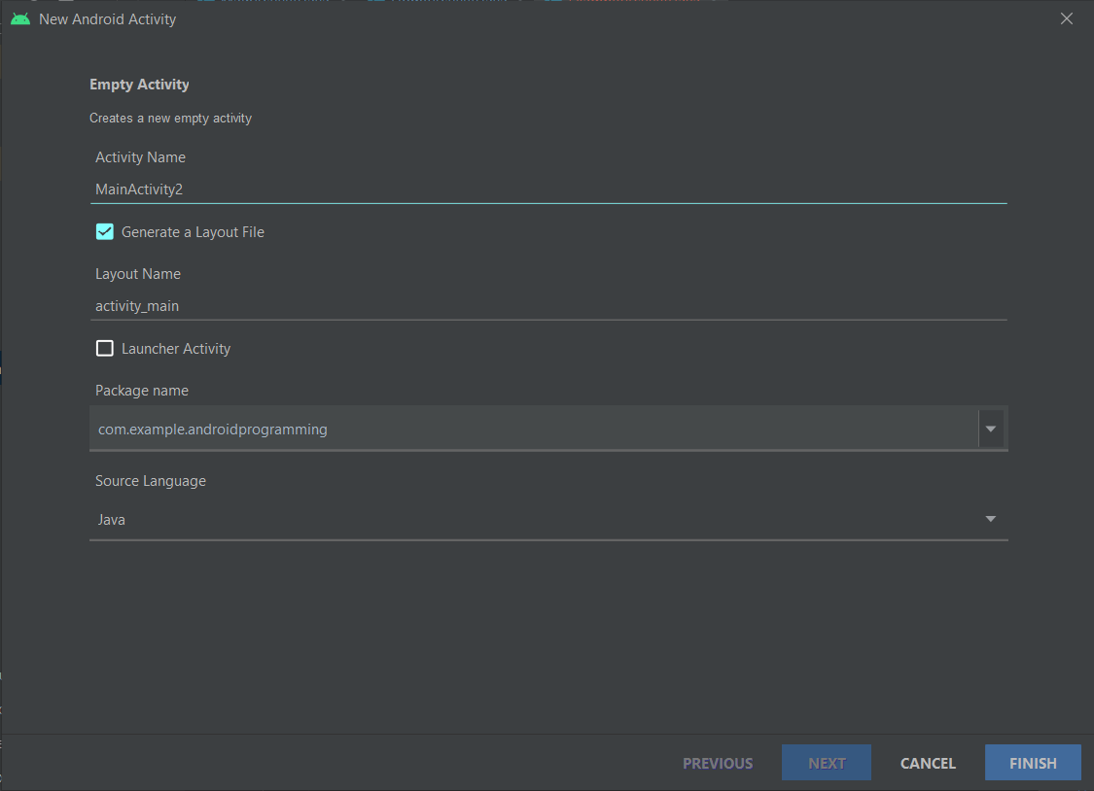
Activity creation
Every activities, to be used, must have an associated <activity> tag in AndroidManifest.xml
Android Studio takes care to do this for you
Right click on destination activity code package -> new -> activity -> choose activity type
You must choose:
Activity name
Associated layout file
Destination package
Source language
By default, android studio extends AppCompatActivity

Slide 27
Intents
Are a message-passing mechanism, you can use intents to request an action from another app component.
Are fondamental used for:
Starting activities
Interact with other app (https://developer.android.com/guide/components/intents-common)
Delivering a broadcast
Starting a service
https://developer.android.com/guide/components/intents-filters
There are 2 types of intents:
Explicit intents: specify which application will satisfy the intent, by supplying either the target app's package name or a fully-qualified component class name. (e.g starting activity)
Implicit intents: do not name a specific component, but instead declare a general action to perform, which allows a component from another app to handle it. (e.g send email)

Slide 28
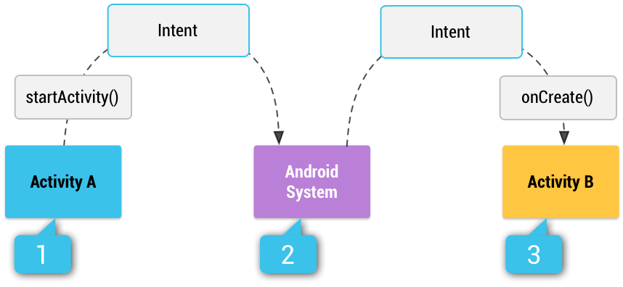
Implicit intents and Intent filters
If you use implicit intents, system compare the contents of your intent to intent filters in manifest of other app on the device, then start related components.
In case of multiple intent filters user must choose (e.g. send email)
Intent filter: tag in aminifest which specifies the type of intetnts that the component is able to receive

Slide 29
Building an intent
Intent(Context packageContext, Class<?> cls) is the most common constructor that create an explicit intent.
Infromation contained in intent are:
Component name: name of the component to start; if it is present intent is explicit, instead, intent is implicit.
This is represented by ComponentName field in Intent class, you can set that in Intent constructor using setComponent() method (e.g. com.example.MainActivity)
Action: a string that species the generic action. Every available action are contained in Intetn class, are representend by final static string. (e.g ACTION_SEND, ACTION_VIEW are the most common actions used to start activities)
You can set action in intent constructor or using setAction() method
Category: A string containing additional information about the kind of component that should handle the intent. (common category are CATEGORY_LAUNCHER target activity is the initial activity)
You can set category using addCategory() methods
Extras: Key-value pairs that carry additional information required to accomplish the requested action.
You can set single extra using putExtra() method or you can set a Bundle of extras using putExtras()
Flags: may instruct the Android system how to launch an activity and how to treat it after it's launched
You can set flags using setFlags() method
Data: Uri object represent data and MIME type represent type of data
You can set Uri with setData() method and set MIME using setType()
https://developer.android.com/reference/android/content/Intent

Slide 30
Actions
Android platform provide native actions:
ACTION_DELETE: starts activity that lets dele the data specified in URI
ACTION_DIAL: starts dialer app (e.g. phone) with the number in URI
ACTION_EDIT: starts activity that can edit data URI
action
ACTION_WEB_SEARCH: opens Browser
ACTION_SEARCH: starts specific search activity
ACTION_SENDTO: starts app that can send data to contact specified in URI
ACTION_SEND: starts activity that can send data URI (need MIME and EXTRAS)
ACTION_VIEW: common generic

Slide 31
Starting activities
To start an activity from another one activity class provide startActivity() method that required an explicit intent
public void startActivity(Intent intent)
Intent intent = new Intent(SourceActivity.this, DestinationActivity.class) ;
startActivity(intent);
DestinationActivity will be created, started, and resumme, replacing the SourceActivity at the top of activity stack.

Slide 32
Sharing data between activities
Intent support putExtra methods, you can add data to share to the new activity
In SourceActivity:
String stringValue = "Android programming";
Intent intent = new Intent(SourceActivity.this, DestinationActivity.class) ;
Intent.putExtra("key", stringValue);
startActivity(intent);
In DestinationActivity:
Bundle bundle = getIntent().getExtras();
String stringValue = bundle.getString("key");

Slide 33
User interface design

Slide 34
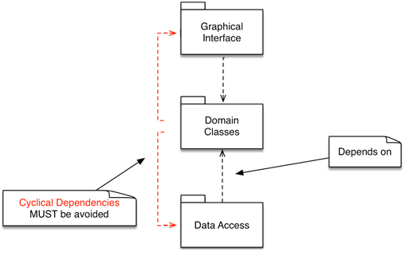
Intro
User interface is everything that the user can see and interact with.
In android you can create UI in Java or Kotlin code or using XML resources, is best practice using second mode to guarantee separation of domain code from UI code
Android provides a variety of pre-built UI components such as structured layout objects and UI controls that allow you to build the graphical user interface for your app.
Android also provides other UI modules for special interfaces such as dialogs, notifications, and menus.

Slide 35
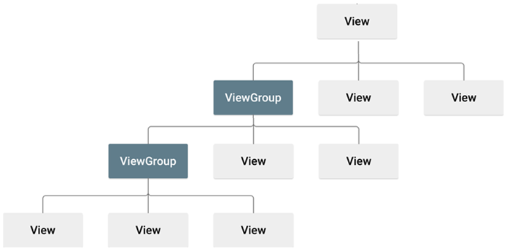
View hierarchy
All UI is built using View hierarchy, which is structured using composite pattern
ViewGroup: is an invisible container that defines the layout structure for View and other ViewGroup objects, are usually called "layouts"
View: represent individual UI elements (e.g. Button, TextView), are usually called "widgets"

Slide 36
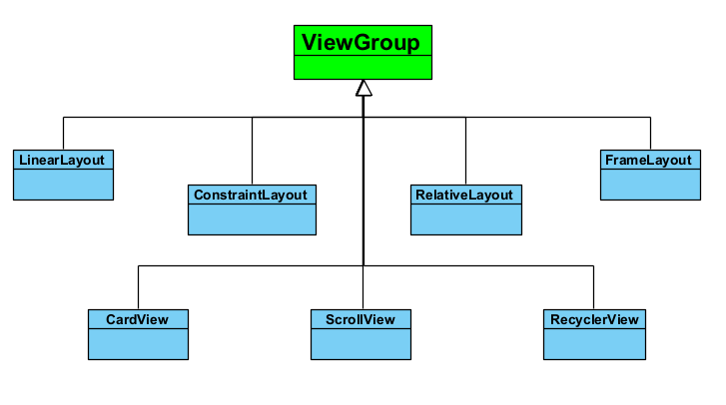
ViewGroup
The ViewGroup is the base class for layouts and views containers
Every subclass of ViewGroup provides a different layout structure
Most important layouts are:
ConstraintLayout
LinearLayout
RelativeLayout
FrameLayout
Most important views containers are:
ScrollView
RecyclerView
CardView

Slide 37
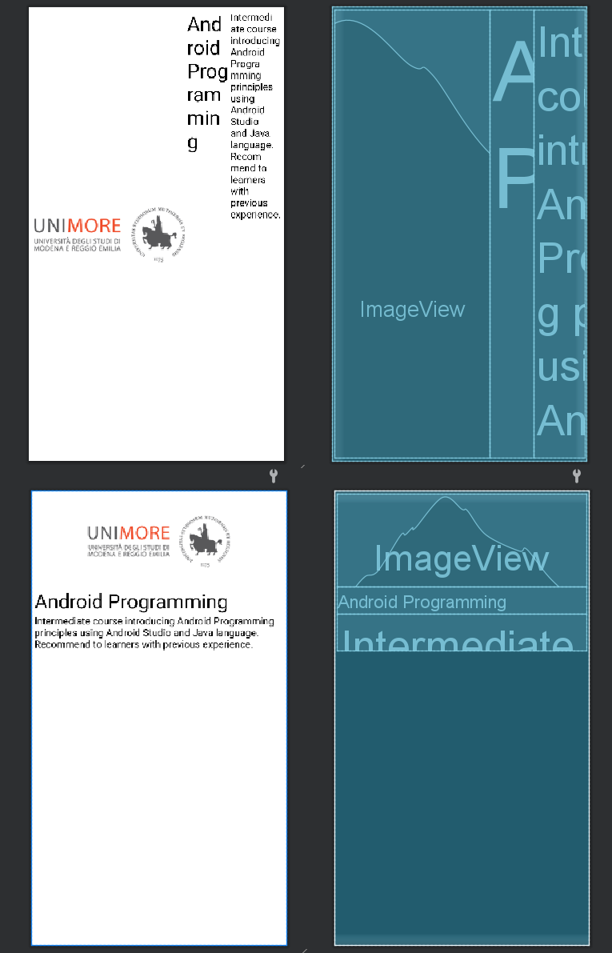
LinearLayout

Slide 38
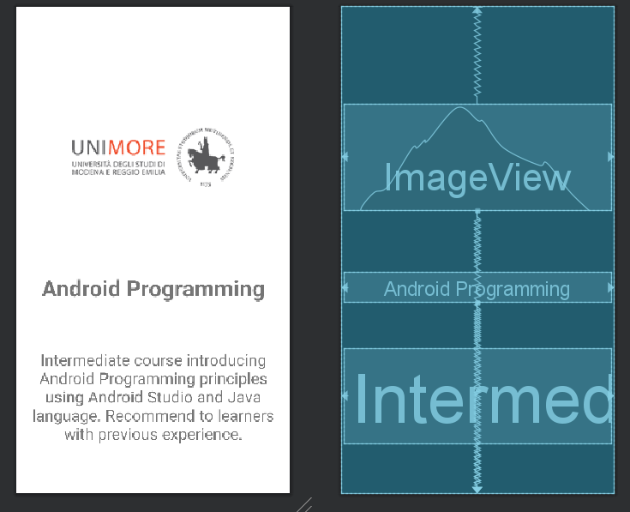
ConstraintLayout

Slide 39
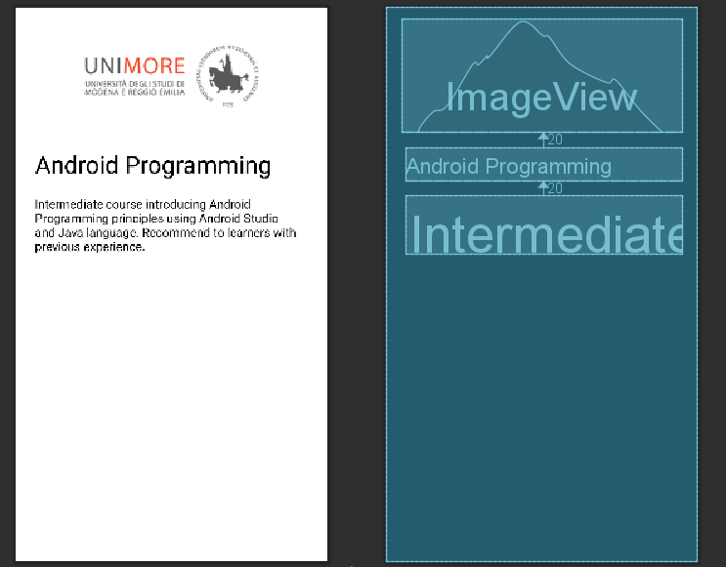
RelativeLayout

Slide 40
ScrollView

Slide 41
View

